Slide 1
Data Mining & Warehousing
By
Prof. Dr. O.P.Vyas
DAAD Fellow (Germany), AOTS Fellow(Japan)
Indian Institute of Information Technology, Allahabad

Slide 2
Supervised Learning: Advances
Linear Classifiers
Support Vector Machines
Classification by Using Frequent Patterns
Lazy Learners (or Learning from Your Neighbors)
Other Classification Methods
Additional Topics Regarding Classification
Summary

Slide 3
Classification: Advances
Generative Vs Discriminative models
Linear Classifiers
Support Vector Machines
Lazy Learners (or Learning from Your Neighbors)
Other Classification Methods
Additional Topics Regarding Classification
Summary

Slide 4
Generative models vs. discriminative models
There are two broad classes of methods for determining the parameters of a linear classifier .
Methods of the first class model conditional density functions . Examples of such algorithms include:
  Linear Discriminant Analysis (or Fisher's linear discriminant) (LDA)—assumes Gaussian conditional density models
  Naive Bayes classifier—assumes independent binomial conditional density models.
The second set of methods includes discriminative models, which attempt to maximize the quality of the output on a training set. Additional terms in the training cost function can easily perform regularization of the final model. Examples of discriminative training of linear classifiers include
Logistic regression—maximum likelihood estimation of assuming that the observed training set was generated by a binomial model that depends on the output of the classifier.
Perceptron—an algorithm that attempts to fix all errors encountered in the training set
Support vector machine—an algorithm that maximizes the margin between the decision hyperplane and the examples in the training set.

Slide 5
Discriminative Classifiers
Advantages
  prediction accuracy is generally high
    As compared to Bayesian methods – in general
  robust, works when training examples contain errors
  fast evaluation of the learned target function
    Bayesian networks are normally slow
Criticism
  long training time
  difficult to understand the learned function (weights)
    Bayesian networks can be used easily for pattern discovery
  not easy to incorporate domain knowledge
    Easy in the form of priors on the data or distributions
Data Mining: Concepts and Techniques

Slide 6
Linear Classification
In the field of machine learning, the goal of classification is to use an object's characteristics to identify which class (or group) it belongs to.
Binary Classification problem
x
x
The data above the orange line belongs to class ‘x’
The data below orange line belongs to class ‘o’
Examples: SVM, Perceptron, Probabilistic Classifiers
x
x
x
x
x
x
o
x
o
x
o
o
o
o
o
o
o
o
o
o
o

Slide 7
Lazy vs. Eager Learning
Lazy vs. eager learning
  Lazy learning (e.g., instance-based learning): Simply stores training data (or only minor processing) and waits until it is given a test tuple
  Eager learning (the above discussed methods): Given a set of training tuples, constructs a classification model before receiving new (e.g., test) data to classify
Lazy: less time in training but more time in predicting
Accuracy
  Lazy method effectively uses a richer hypothesis space since it uses many local linear functions to form an implicit global approximation to the target function
  Eager: must commit to a single hypothesis that covers the entire instance space

Slide 8
Lazy Learner: Instance-Based Methods
Instance-based learning:
  Store training examples and delay the processing (“lazy evaluation”) until a new instance must be classified
Typical approaches
  k-nearest neighbor approach
    Instances represented as points in a Euclidean space.
  Locally weighted regression
    Constructs local approximation
  Case-based reasoning
    Uses symbolic representations and knowledge-based inference

Slide 9

Linear classifier
A linear classifier achieves this by making a classification decision based on the value of a linear combination of the characteristics.
An object's characteristics are also known as feature values and are typically presented to the machine in a vector called a feature vector.
If the input feature vector to the classifier is a real vector x , then the output score is
where w is a real vector of weights and f is a function that converts the dot product of the two vectors into the desired output. (In other words, w is a one-form or linear functional mapping x onto R.)
The weight vector w is learned from a set of labeled training samples. Often f is a simple function that maps all values above a certain threshold to the first class and all other values to the second class.

Slide 10
Support Vector Machines
When data is unlabelled, supervised learning is not possible, and an unsupervised learning approach is required, which attempts to find natural clustering of the data to groups, and then map new data to these formed groups.
The support-vector clustering algorithm, created by Hava Siegelmann and Vladimir Vapnik, applies the statistics of support vectors, developed in the support vector machines algorithm, to categorize unlabeled data, and is one of the most widely used clustering algorithms in industrial applications.

Slide 11
SVM—History and Applications
Vapnik and colleagues (1992)—groundwork from Vapnik & Chervonenkis’ statistical learning theory in 1960s
Features: training can be slow but accuracy is high owing to their ability to model complex nonlinear decision boundaries (margin maximization)
Used for: classification and numeric prediction
Applications:
  handwritten digit recognition, object recognition, speaker identification, benchmarking time-series prediction tests

Slide 12
SVM—General Philosophy
Let us consider the data as given below in 2-D space is Linearly separable.
Here we try to create two clusters from the given data…Labelled or un-labeled?
Small Margin
Large Margin
Support Vectors

Slide 13


SVM—Margins and Support Vectors
We can draw a Line as shown in First Figure as small margin but also another one Shown in Second Figure…which one is better..? Large?
Data Mining: Concepts and Techniques

Slide 14
SVM
“
.
A Support Vector Machine (SVM) is a discriminative classifier formally defined by a separating hyperplane or Straight Line in 2D.
SVM is a machine learning algorithm which is mostly used in classification problems. In this algorithm, we plot each data item as a point in n-dimensional space (where n is number of features you have) with the value of each feature being the value of a particular coordinate. Then, we perform classification by finding the hyper-plane that differentiate the two classes very well
In other words, given labeled training data (supervised learning), the algorithm outputs an optimal hyperplane which categorizes new examples.
In two dimentional space this hyperplane is a line dividing a plane in two parts where in each class lay in either side

Slide 15
SVM—When Data Is Linearly Separable
m
Let data D be (X₁, y₁), …, (X_{|D|}, y_{|D|}), where X_{i} is the set of training tuples associated with the class labels y_{i}
There are infinite lines (hyperplanes) separating the two classes but we want to find the best one (the one that minimizes classification error on unseen data)
SVM searches for the hyperplane with the largest margin, i.e., maximum marginal hyperplane (MMH)

Slide 16
SVM—Linearly Separable
A separating hyperplane can be written as
    W ● X + b = 0
  where W={w₁, w₂, …, w_{n}} is a weight vector and b a scalar (bias)
For 2-D it can be written as, a straight Line
    w₀ + w₁ x₁ + w₂ x₂ = 0
The hyperplane defining the sides of the margin:
    H₁: w₀ + w₁ x₁ + w₂ x₂ ≥ 1 for y_{i} = +1, and
    H₂: w₀ + w₁ x₁ + w₂ x₂ ≤ – 1 for y_{i} = –1
Any training tuples that fall on hyperplanes H₁ or H₂ (i.e., the
sides defining the margin) are support vectors
This becomes a constrained (convex) quadratic optimization problem: Quadratic objective function and linear constraints → Quadratic Programming (QP) → Lagrangian multipliers

Slide 17
Why Is SVM Effective on High Dimensional Data?
The complexity of trained classifier is characterized by the # of support vectors rather than the dimensionality of the data
The support vectors are the essential or critical training examples —they lie closest to the decision boundary (MMH)
If all other training examples are removed and the training is repeated, the same separating hyperplane would be found
The number of support vectors found can be used to compute an (upper) bound on the expected error rate of the SVM classifier, which is independent of the data dimensionality
Thus, an SVM with a small number of support vectors can have good generalization, even when the dimensionality of the data is high

Slide 18

SVM when data are not linearly separable…
Approach defined for Linear SVM can be extended to crate non-linear SVMs…

Slide 19


SVM—Linearly Inseparable
Transform the original input data into a higher dimensional space
Search for a linear separating hyperplane in the new space

Slide 20
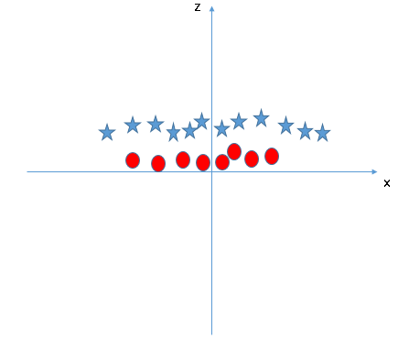
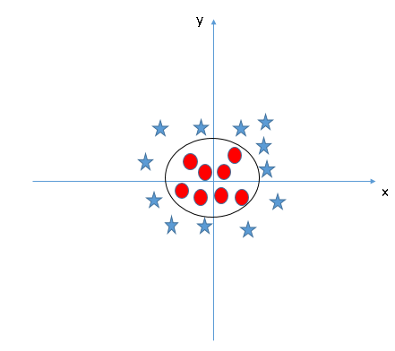
SVMs & Kernel
Functions
In above plot, points to consider are:
All values for z would be positive always because z is the squared sum of both x and y
In the original plot, red circles appear close to the origin of x and y axes, leading to lower value of z and star relatively away from the origin result to higher value of z.
In SVM, it is easy to have a linear hyper-plane between these two classes.
But, another burning question which arises is, should we need to add this feature manually to have a hyper-plane. No, SVM has a technique called the kernel trick. These are functions which takes low dimensional input space and transform it to a higher dimensional space i.e. it converts not separable problem to separable problem, these functions are called kernels.
It is mostly useful in non-linear separation problem. Simply put, it does some extremely complex data transformations, then find out the process to separate the data based on the labels or outputs you’ve defined.
When we look at the hyper-plane in original input space it looks like a circle:

Slide 21
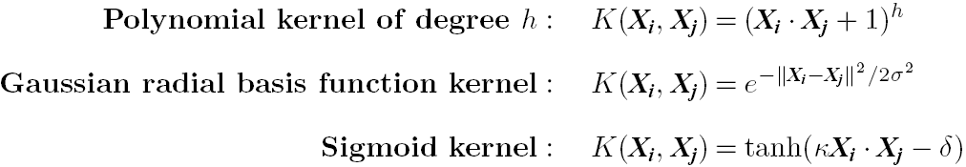
SVM: Different Kernel functions
Instead of computing the dot product on the transformed data, it is math. equivalent to applying a kernel function K(X_{i}, X_{j}) to the original data, i.e., K(X_{i}, X_{j}) = Φ(X_{i}) Φ(X_{j})
Typical Kernel Functions
SVM can also be used for classifying multiple (> 2) classes and for regression analysis (with additional parameters)

Slide 22
Scaling SVM by Hierarchical Micro-Clustering
SVM is not scalable to the number of data objects in terms of training time and memory usage
H. Yu, J. Yang, and J. Han, “Classifying Large Data Sets Using SVM with Hierarchical Clusters”, KDD'03)
CB-SVM (Clustering-Based SVM)
  Given limited amount of system resources (e.g., memory), maximize the SVM performance in terms of accuracy and the training speed
  Use micro-clustering to effectively reduce the number of points to be considered
  At deriving support vectors, de-cluster micro-clusters near “candidate vector” to ensure high classification accuracy

Slide 23
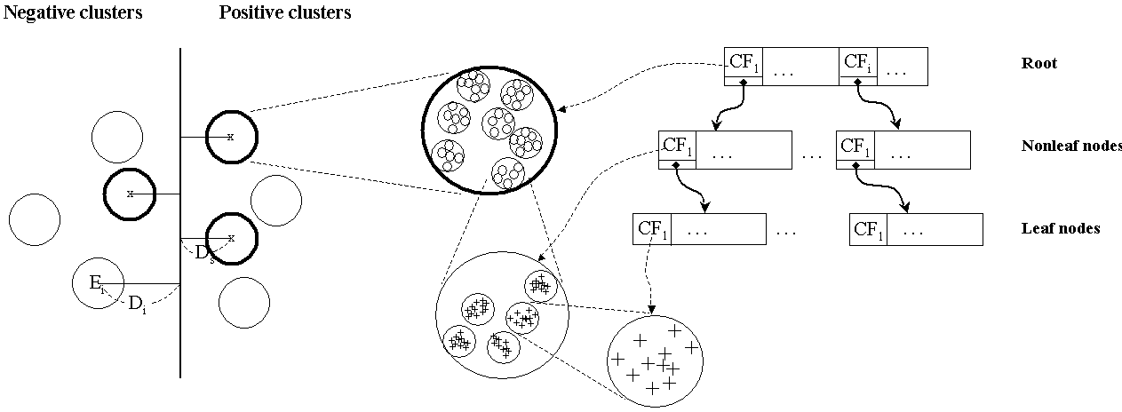
CF-Tree: Hierarchical Micro-cluster
Read the data set once, construct a statistical summary of the data (i.e., hierarchical clusters) given a limited amount of memory
Micro-clustering: Hierarchical indexing structure
  provide finer samples closer to the boundary and coarser samples farther from the boundary

Slide 24
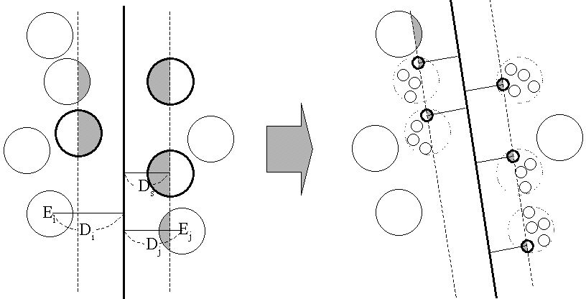
Selective Declustering: Ensure High Accuracy
CF tree is a suitable base structure for selective declustering
De-cluster only the cluster E_{i} such that
  D_{i} – R_{i} < D_{s}, where D_{i} is the distance from the boundary to the center point of E_{i} and R_{i} is the radius of E_{i}
  Decluster only the cluster whose subclusters have possibilities to be the support cluster of the boundary
    “Support cluster”: The cluster whose centroid is a support vector

Slide 25
CB-SVM Algorithm: Outline
Construct two CF-trees from positive and negative data sets independently
  Need one scan of the data set
Train an SVM from the centroids of the root entries
De-cluster the entries near the boundary into the next level
  The children entries de-clustered from the parent entries are accumulated into the training set with the non-declustered parent entries
Train an SVM again from the centroids of the entries in the training set
Repeat until nothing is accumulated

Slide 26
Accuracy and Scalability on Synthetic Dataset
Experiments on large synthetic data sets shows better accuracy than random sampling approaches and far more scalable than the original SVM algorithm

Slide 27
SVM vs. Neural Network
SVM
  Deterministic algorithm
  Nice generalization properties
  Hard to learn – learned in batch mode using quadratic programming techniques
  Using kernels can learn very complex functions
Neural Network
  Nondeterministic algorithm
  Generalizes well but doesn’t have strong mathematical foundation
  Can easily be learned in incremental fashion
  To learn complex functions—use multilayer perceptron (nontrivial)

Slide 28
SVM Related Links
SVM Website: http://www.kernel-machines.org/
Representative implementations
  LIBSVM: an efficient implementation of SVM, multi-class classifications, nu-SVM, one-class SVM, including also various interfaces with java, python, etc.
  SVM-light: simpler but performance is not better than LIBSVM, support only binary classification and only in C
  SVM-torch: another recent implementation also written in C

Slide 29
Multiclass Classification
Classification involving more than two classes (i.e., > 2 Classes)
Method 1. One-vs.-all (OVA): Learn a classifier one at a time
  Given m classes, train m classifiers: one for each class
  Classifier j: treat tuples in class j as positive & all others as negative
  To classify a tuple X, the set of classifiers vote as an ensemble
Method 2. All-vs.-all (AVA): Learn a classifier for each pair of classes
  Given m classes, construct m(m-1)/2 binary classifiers
  A classifier is trained using tuples of the two classes
  To classify a tuple X, each classifier votes. X is assigned to the class with maximal vote
Comparison
  All-vs.-all tends to be superior to one-vs.-all
  Problem: Binary classifier is sensitive to errors, and errors affect vote count

Slide 30
Semi-Supervised Classification
Semi-supervised: Uses labeled and unlabeled data to build a classifier
Self-training:
  Build a classifier using the labeled data
  Use it to label the unlabeled data, and those with the most confident label prediction are added to the set of labeled data
  Repeat the above process
  Adv: easy to understand; disadv: may reinforce errors
Co-training: Use two or more classifiers to teach each other
  Each learner uses a mutually independent set of features of each tuple to train a good classifier, say f₁
  Then f₁ and f₂ are used to predict the class label for unlabeled data X
  Teach each other: The tuple having the most confident prediction from f₁ is added to the set of labeled data for f₂, & vice versa
Other methods, e.g., joint probability distribution of features and labels

Slide 31
Active Learning
Class labels are expensive to obtain
Active learner: query human (oracle) for labels
Pool-based approach: Uses a pool of unlabeled data
  L: a small subset of D is labeled, U: a pool of unlabeled data in D
  Use a query function to carefully select one or more tuples from U and request labels from an oracle (a human annotator)
  The newly labeled samples are added to L, and learn a model
  Goal: Achieve high accuracy using as few labeled data as possible
Evaluated using learning curves: Accuracy as a function of the number of instances queried (# of tuples to be queried should be small)
Research issue: How to choose the data tuples to be queried?
  Uncertainty sampling: choose the least certain ones
  Reduce version space, the subset of hypotheses consistent w. the training data
  Reduce expected entropy over U: Find the greatest reduction in the total number of incorrect predictions

Slide 32
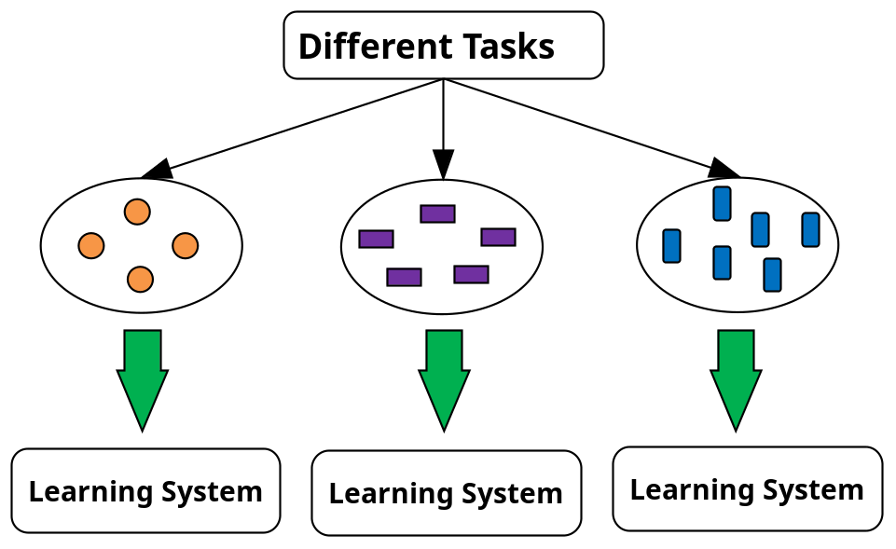
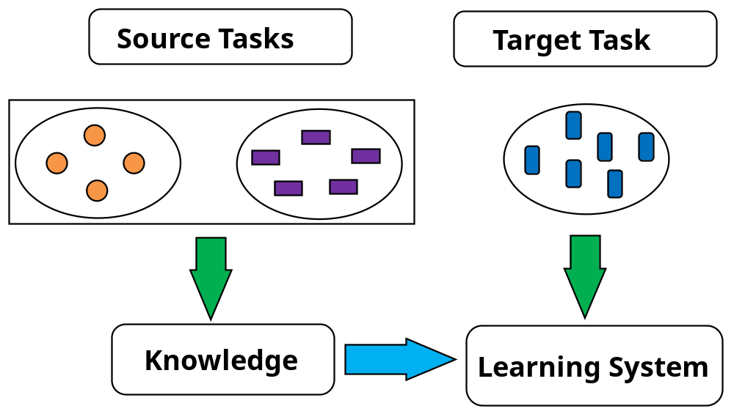
Transfer Learning: Conceptual Framework
Transfer learning: Extract knowledge from one or more source tasks and apply the knowledge to a target task
Traditional learning: Build a new classifier for each new task
Transfer learning: Build new classifier by applying existing knowledge learned from source tasks
Traditional Learning Framework
Transfer Learning Framework

Slide 33
Transfer Learning: Methods and Applications
Applications: Especially useful when data is outdated or distribution changes, e.g., Web document classification, e-mail spam filtering
Instance-based transfer learning: Reweight some of the data from source tasks and use it to learn the target task
TrAdaBoost (Transfer AdaBoost)
  Assume source and target data each described by the same set of attributes (features) & class labels, but rather diff. distributions
  Require only labeling a small amount of target data
  Use source data in training: When a source tuple is misclassified, reduce the weight of such tupels so that they will have less effect on the subsequent classifier
Research issues
  Negative transfer: When it performs worse than no transfer at all
  Heterogeneous transfer learning: Transfer knowledge from different feature space or multiple source domains
  Large-scale transfer learning

Slide 34
Bibliography
J. Han and M. Kamber. Data Mining – Concepts and Techniques. 2001. Morgan Kaufmann.
M. Kantardzic. Data Mining – Concepts, Models, Methods, and Algorithms. 2003. IEEE.
M. H. Dunham. Data Mining – Introductory and Advanced Topics.
I.H. Witten and E. Frank. Data Mining – Practical Machine Learning Tools and Techniques with Java Implementations. 2000. Morgan Kaufmann.
Ranjana Vyas- Ph.D. Thesis “ Exploring some data mining techniques for DSS through efficient Knowledge Management” 2008.
Fall 2003
CSE 494 by H. Liu

